Slide 1

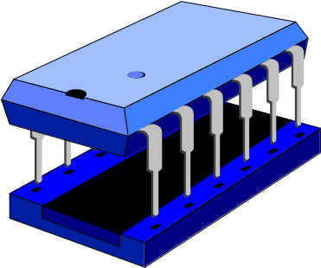
Pentium Architecture:
Registers & Addressing Modes
Professor Kin K. Leung
kin.leung@imperial.ac.uk
www.commsp.ee.ic.ac.uk/~kkleung/
Heavily based on materials by Dr. Naranker Dulay
K.K. Leung
Pentium Registers & Addressing Modes

Slide 2
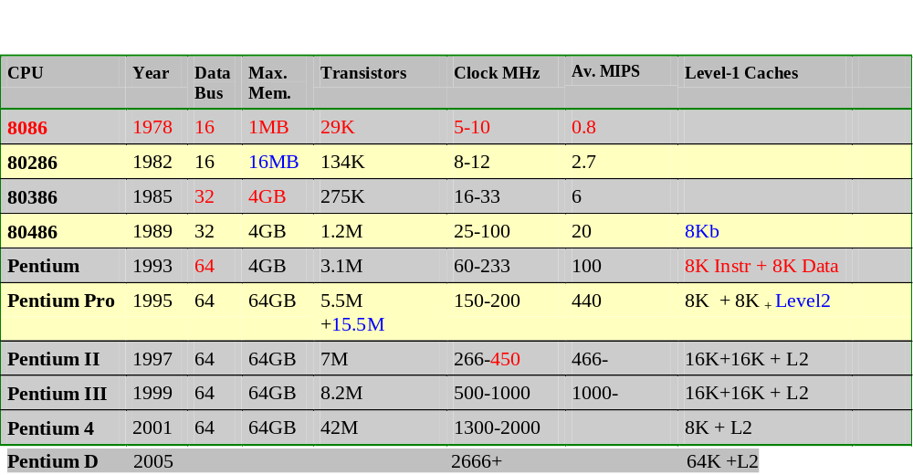
Intel Pentium Family
K.K. Leung
Pentium Registers & Addressing Modes
Notes:
4-bit 4004 1971
8-bit 8008 1971
8-bit 8080 1973 (16-bit address+stack)
8-bit 8085 Integrated 8080
80186 Integrated 8086
8088 8-bit data bus, used in 1st IBM PC
64-bit, 128 integer registers, 128 floating point registers
Backward compatible
with x86
128 bit instruction format versus 8..108 bit in x86
Each 128-bit instruction holds 3 smaller instructions, which can be executed in parallel.

Slide 3
Registers (32-bit)
31 0
eax
‘A’ register
ebx
‘B’ register
ecx
‘C’ register
edx
‘D’ register
esi
source index register
edi
destination index register
esp
stack pointer Register
ebp
base pointer Register
K.K. Leung
Pentium Registers & Addressing Modes

Slide 4
Registers (16-bit)
31 16 15 0
eax
ax
The least significant 16-bits of these registers have an additional register name that can be used for accessing just those 16-bits.
Note: There are no register names for the most significant 16-bits
ebx
bx
ecx
cx
edx
dx
esi
si
edi
di
esp
sp
ebp
bp
K.K. Leung
Pentium Registers & Addressing Modes

Slide 5
Registers (8-bit)
31 16 15 0
15 8 7 0
eax
ax
ah
al
ebx
bx
bh
bl
ecx
cx
ch
cl
edx
dx
dh
dl
The 2 least significant bytes of registers eax, ebx, ecx and edx also have register names, that can be used for accessing those bytes.
Note: There are no register names for accessing the 2 least significant bytes of esi, edi, esp, ebp.
K.K. Leung
Pentium Registers & Addressing Modes

Slide 6
Instruction Pointer Register
32-bit
eip
The instruction pointer register eip holds the address of the next instruction to be executed. The eip register corresponds to the program counter register in other architectures.
eip is not normally manipulated explicitly by programs. However it is updated by special control-flow CPU instructions (e.g. call, jmp, ret) that are used to implement if's, while's, method calls etc.
K.K. Leung
Pentium Registers & Addressing Modes

Slide 7
Flags Register
32-bit
eflags
The eflags register holds information about the current state of the CPU. Its 32-bits are mostly of interest to the Operating System; however, some of its bits are set/cleared after arithmetic instructions are executed, and these bits are used by conditional branch instructions:
Zero Flag (Bit 6) Set (=1) if the result is zero, cleared (=0) otherwise.
Sign Flag (Bit 7) Set to MS-bit of result, which is the sign bit of a signed integer.
Overflow Flag (Bit 11) Set if result is too large a positive number or too small a negative number, cleared otherwise.
Carry Flag (Bit 0) Set if carry or borrow out of MS-bit, cleared otherwise. Used in multi-precision arithmetic
Parity Flag (Bit 2) Set if LS-byte of result contains an even number of 1 bits, cleared otherwise.
K.K. Leung
Pentium Registers & Addressing Modes

Slide 8
Basic data types
7 0
byte
15 8
7 0
word
31 16 15 0
high word
low word
doubleword
63 32 31 0
high doubleword
low doubleword
quadword
K.K. Leung
Pentium Registers & Addressing Modes

Slide 9
Main Memory
Byte Addressable, Little Endian, Non-Aligned Accesses Allowed
Address
0
1
2
3
4
5
6
7
8
9
A
B
C
D
E
F
12
31
CB
74
EF
F0
0B
23
A4
1F
36
06
FE
7A
FF
45
Byte at address 9H ?
Byte at address 0BH ?
Word at address 1H ?
Word at address 2H ?
Word at address 6H ?
Doubleword at address 0AH ?
Quadword at address 6H ?
K.K. Leung
Pentium Registers & Addressing Modes
Notes:
1F
06
CB 31
74 CB
23 0B
7A FE 06 36
7A FE 06 36 1F A4 23 0B

Slide 10
Instruction Format
Most Pentium instructions have either 2, 1 or 0 operands and take one of the forms:
label: opcode Destination, Source ; comments
label: opcode Operand ; comments
label: opcode ; comments
label is an optional user-defined identifier that will have a value that is the address of the instruction or data item that follows.
We'll use the netwide assembler (nasm) which follows Intel syntax. Beware: some Linux/BSD Pentium assemblers follow a different syntax.
K.K. Leung
Pentium Registers & Addressing Modes

Slide 11
Directives for “Global” Variables (1)
Data declaration directives are special assembler commands that allow “global” data (variables) to be declared. Global data is mapped to fixed memory locations and can be accessed by using the name of the variable. The address of the global variable is encoded into Pentium instructions as required.
Initialised data directives db (byte), dw (word), dd (doubleword)
users db 3 ; byte with value 3
age dw 21 ; word with value 21
total dd 999 ; doubleworld with value 999
message db “hello” ; 5-byte string hello
sequence dw 1, 2, 3 ; 3-words with values 1, 2 and 3
array times 100 dw 33 ; 100-words, each with value 33
K.K. Leung
Pentium Registers & Addressing Modes

Slide 12
Directives for “Global” Variables (2)
Uninitialised data can be reserved with resb (byte), resw (word), resd (doubleword)
tiny resb 10 ; reserve 10 bytes
little resw 100 ; reserve 100 words (200 bytes)
big resd 1000 ; reserve 1000 doubleworlds (4000 bytes)
K.K. Leung
Pentium Registers & Addressing Modes

Slide 13
equ directive for constants
We can define named constants with an equ directive, e.g.:
dozen equ 12
century equ 100
K.K. Leung
Pentium Registers & Addressing Modes

Slide 14
Operands (Addressing Modes)
Register Operands
e.g. eax, dx, al, si, bp
Immediate Operands (i.e. Constants)
e.g. 23, 67H, 101010B, ‘R’, ‘ON’
Memory Operands [BaseReg + Scale*IndexReg + Displacement]
e.g. [24], [bp], [esi+2],[bp+8*di+16]
Note: The source and destination operands of a 2 operand Pentium instruction CANNOT both be memory operands.
K.K. Leung
Pentium Registers & Addressing Modes

Slide 15
Examples
Label Instruction Comment
mov ah, cl ; ah = cl
add ax, [ebx] ; ax = ax + memory16[ebx]
mov eax,[ebp+4] ; eax = memory32[ebp+4]
sub eax,45 ; eax = eax - 45
mov byte[ecx],45 ; memory8[ecx] = 45
add ch, [22] ; ch = ch + memory8[22]
K.K. Leung
Pentium Registers & Addressing Modes

Slide 16
More Examples
Label Instruction Comment
neg ax ; ax = -ax
cmp eax, ecx ; compare operands and set
; eflags register
je end ; if flags.zf = 1 then
; eip = address end
call print ; call method print
end: ret ; return from method
K.K. Leung
Pentium Registers & Addressing Modes

Slide 17
Register Operand
Register
Operand found in the specified register
mov eax, edx
mov ah, bl
mov esp, ebp
mov edi, eax
Depending on the instruction and sometimes the processor model, a register operand can be in any of the general purpose registers. Some instructions will also accept the eflags and eip register.
Some instructions such as idiv implicitly use operands contained in a pair of registers, e.g. in ax and dx.
For most 2-operand instructions destination & source operands must be of the same size
K.K. Leung
Pentium Registers & Addressing Modes

Slide 18
Immediate (Constant) Operand
Constant
Operand is an immediate
(i.e. constant) value
mov eax, 22
mov ecx, 16H
mov ax, 10110B
mov ebx, 12345678H
mov bx, age
mov eax, total
mov al, ‘a’
mov ax, ‘mp’
Immediate values are encoded directly into the instruction.
Are not normally applicable for destination operands.
If a data variable is used as an immediate operand then the address of the variable is used. Microsoft's assembler (MASM) requires # before the variable or the keyword OFFSET.
K.K. Leung
Pentium Registers & Addressing Modes

Slide 19
Memory Operands
Memory operands specify an address using expressions of the form:
[ Baseregister + Scale*Indexregister + Displacement ]
Base register: eax, ebx, ecx, edx, esi, edi, ebp, esp
Index register: eax, ebx, ecx, edx, esi, edi, ebp
Scale: either 2 or 4 or 8
Displacement: constant value
Expressions can be re-ordered, e.g. displacement can be written first. Omission of different parts of the expression give different modes.
Note: The size of an operand is normally inferred from the Instruction or register operand. In case of ambiguity we must explicitly prefix the operand with byte or word or dword to specify the size of the operand, e.g. byte [ebx], word 16, dword [ebx+2*edi+list]
K.K. Leung
Pentium Registers & Addressing Modes

Slide 20
Displacement (Direct Addressing)
[ Displacement ]
Specified constant value (called the displacement) gives address.
mov eax, [22]
mov [16H], esi
mov byte [22], 98
mov ebx, [12345678H]
mov cx, [users]
mov [mypointer], ah
Displacements are encoded directly into the instruction.
Direct addressing allows us to access variables with a fixed address -> global variables.
The nasm assembler allows displacement to be a constant expression, e.g. [list+22]
K.K. Leung
Pentium Registers & Addressing Modes

Slide 21
Example 1: mov ax,[22]
0
ax
2
-637
+22
...
, 22
22
-637
Instruction
K.K. Leung
Pentium Registers & Addressing Modes

Slide 22
Example 2: mov byte [22],98
0
2
+22
...
22, 98
22
98
Example 3:
mov word [26],99
Instruction
24
26
99
26, 99
K.K. Leung
Pentium Registers & Addressing Modes

Slide 23
Base (Register Indirect)
[ Base ]
Contents of specified Base Register gives address
mov ax, [ebx]
mov [ebp], al
mov eax, [edi]
mov [esi], ah
mov ebx, [esi]
mov [esp], ecx
Since the value in a base register can be updated, this mode can be used to dynamically address (point to) variables in memory (e.g. arrays and objects) based on computed addresses.
K.K. Leung
Pentium Registers & Addressing Modes

Slide 24
Example 1: mov ax,[bx]
0
ax
2
-100
+66
...
bx
66
-100
66
K.K. Leung
Pentium Registers & Addressing Modes

Slide 25
Example 2: mov [bp],al
0
al
2
55
+12
...
bp
12
55
12
K.K. Leung
Pentium Registers & Addressing Modes

Slide 26
Base + Displacement (Register Relative)
[ Base + Displacement] or [Displacement + Base]
Sum of specified Base Register and Displacement gives address offset. Displacement can be negative.
mov ax, [ebx+4]
mov [ebp+2], dh
mov ax, [di–6]
mov dl, [esi+age]
mov [list+ebx], cx
mov dx,[ebp+list–2]
Can be used to access object fields:
Base Register = Start of Object,
Displacement = Position of field
within object.
Can be used to access array elements:
Displacement = start of array,
Base Register = position of array
element
Can be used to access parameters & local variables (covered later)
K.K. Leung
Pentium Registers & Addressing Modes

Slide 27
Example 1: mov ax,[bx+4]
0
ax
2
2244
+12
bx
...
12
bx points to the start of an object with fields X, Y & Z
+0 selects field X
+2 selects field Y
+4 selects field Z
12
X
+4
Y
, +4
16
2244
Instruction
K.K. Leung
Pentium Registers & Addressing Modes

Slide 28
Example 2: mov ax,[bx+4]
ax
0
-99
+4
2
4
A[0]
, +4
6
A[1]
Instruction
+12
8
A[2]
+4 points to start of
Array A
bx holds byte
offset to array
element
10
A[3]
bx
12
A[4]
14
A[5]
12
16
-99
K.K. Leung
Pentium Registers & Addressing Modes

Slide 29
Base + Index (Based Indexed)
[ Base + Index ]
Sum of specified Base Register and Index Register gives address
mov cx, [bx+di]
mov [eax+ebx], ecx
mov ch, [bp+si]
mov [bx+si], sp
mov cl, [edx+edi]
mov [eax+ebx], ecx
mov [bp+di], cx
Can be used to access array elements where start of array is dynamically determined at run-time:
Base Register = start of
array,
Index Register = position of element.
K.K. Leung
Pentium Registers & Addressing Modes

Slide 30
Example: mov ax,[bx+di]
0
ax
2
-27
+12
bx
...
12
Start of Array
12
A[0]
di
+6
14
A[1]
6
16
A[2]
18
-27
Byte offset to array element
K.K. Leung
Pentium Registers & Addressing Modes

Slide 31
Base+Index+Displacement (Based Relative Index)
[ Base + Index + Displacement] or [ Displacement + Base + Index ]
Sum of specified Base Register and Index Register and Displacement gives address
mov ax, [bp+di+10]
mov dh, [bx+di-6]
mov [list+bp+di], dx
mov eax, [ebx+ecx+list+2]
Also known as Relative Based Index
Can be used to access arrays of objects, arrays within objects and arrays on the stack.
K.K. Leung
Pentium Registers & Addressing Modes

Slide 32
Example: mov ax,[dx+di+10]
ax
0
dx
+12
+67
...
12
12
+10
, +10
Instruction
22
A[0]
dx points to start of object
dx+10 points to array field within object
di holds byte offset of array element
+6
24
A[1]
26
A[2]
6
28
+67
di
K.K. Leung
Pentium Registers & Addressing Modes

Slide 33
(Scale*Index) + Displacement (Scaled Index)
[ Scale * Index + Displacement] or [ Displacement + Scale * Index ]
Product of Index Register and a constant scaling factor (2, 4 or 8) added to specified Displacement to give address
mov eax, [4*ecx+4]
mov [2*ebx], cx
mov [list+2*ebx], dx
mov eax, [4*edi+list]
Supports efficient access to array elements when the element size is 2, 4 or 8 bytes, e.g.:
Displacement
= start of array.
Index Register
= position of array element,
Scale
= element size in bytes (but
only 2, 4 or 8)
K.K. Leung
Pentium Registers & Addressing Modes

Slide 34
Example: mov ax,[2*ecx+4]
ax
0
-99
+4
2
Instruction
4
A[0]
2, +4
6
A[1]
8
A[2]
+(2*6)
10
+4 = start of a Array
ecx = position of
array element
Element size
= 2 bytes
A[3]
ecx
12
A[4]
14
A[5]
6
16
-99
K.K. Leung
Pentium Registers & Addressing Modes

Slide 35
Base + (Scale * Index) + Displacement
[ Base + Scale * Index + Displacement] or
[ Displacement + Base + Scale * Index ]
Product of Index Register and a constant scaling factor (2, 4 or 8) added to specified Base Register and Displacement to give address offset.
mov eax, [ebx+4*ecx]
mov [eax+2*ebx] , ecx
mov ax, [ebp+2*edi+age]
mov [32+eax+2*ebx, dx
Supports efficient access to arrays within objects and on the stack when the element size is 2, 4 or 8 bytes.
K.K. Leung
Pentium Registers & Addressing Modes

Slide 36
Example: mov eax,[ebx+4*edx+10]
eax
0
ebx
+12
12349908H
...
12
12
+10
Instruction
ebx points to start of object
ebx+10 points to start of array within object
edx holds “position” of array element.
Element size = 4 bytes
4, +10
22
A[0]
+(4*2)
24
A[0]
26
A[1]
2
28
A[1]
edx
30
9908H
32
1234H
K.K. Leung
Pentium Registers & Addressing Modes

Slide 37
Linux oriented books
Guide to Assembly Language Programming in Linux
Sivarama Dandamudi, Springer, 2005. Good introduction to Linux assembly programming.
Computer Systems: A Programmer’s Perspective
Randal E. Bryant & David O’Hallaron, Prentice-Hall, 2003.
Excellent book.
Geared for Linux/BSD. Uses GNU assembler (gas) and C.
Intel Pentium 4 Manuals
http://developer.intel.com/design/Pentium4/documentation.htm
K.K. Leung
Pentium Registers & Addressing Modes

Slide 38
Internet Resources
PC Assembly Language
Paul Carter
Download from www.drpaulcarter.com/pcasm
The Art of Assembly Language Programming
Randall Hyde
Over 1200 pages!! Download for personal use via:
http://webster.cs.ucr.edu/AoA/index.html
K.K. Leung
Pentium Registers & Addressing Modes

